Slide 1
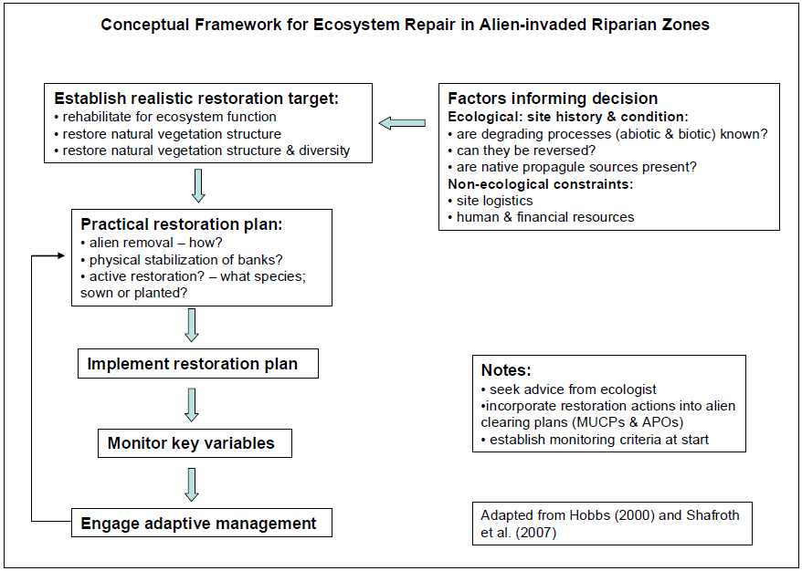
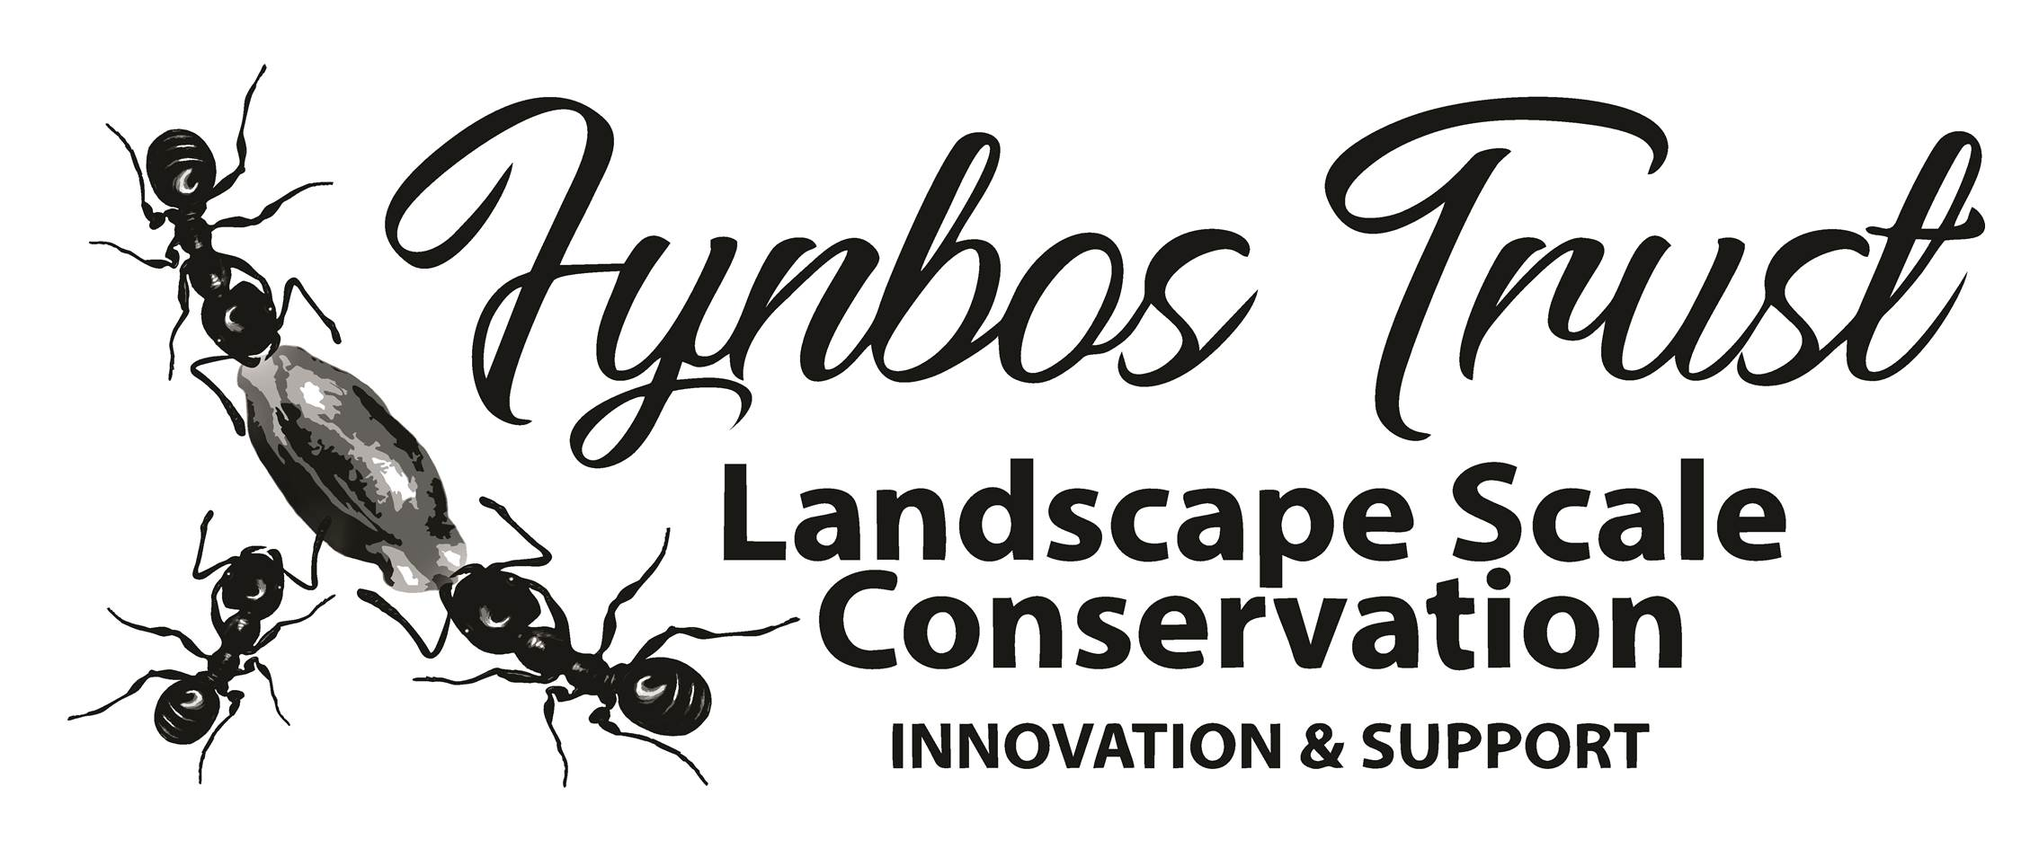
CONCEPTIAL FRAMEWORK FOR RESTORATION /REHABILITATION PLAN
Holmes P.M. Targets for ecosystem repair in riparian ecosystems in Fynbos, Grassland and Savanna biomes. Final report to the Working for Water Programme. July 2007

Slide 2
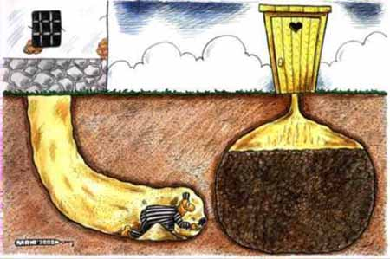
REASONS FOR FAILURE OF RESTORATION/ REHABILITATION PROJECTS
Poor understanding of ecological processes (natural drivers eg fire, browsing, flood-dynamics, succession and spp. Relationships, )
Poor overall planning
landscape context,
timing,
scale,
accurate costing
Poor implementation
- resources
- methods
- cause v. symptoms
- poor ongoing maintenance
Poor adaptive management
Lack of monitoring information
Failure to respond to changing conditions and disturbance processes

