Slide 1
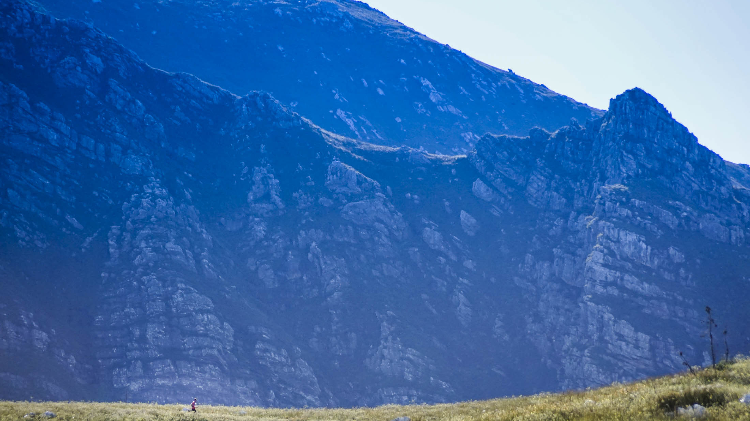
Grootvadersbosch High Mountain Clearing Project
Started in 2020 and on going

Slide 2
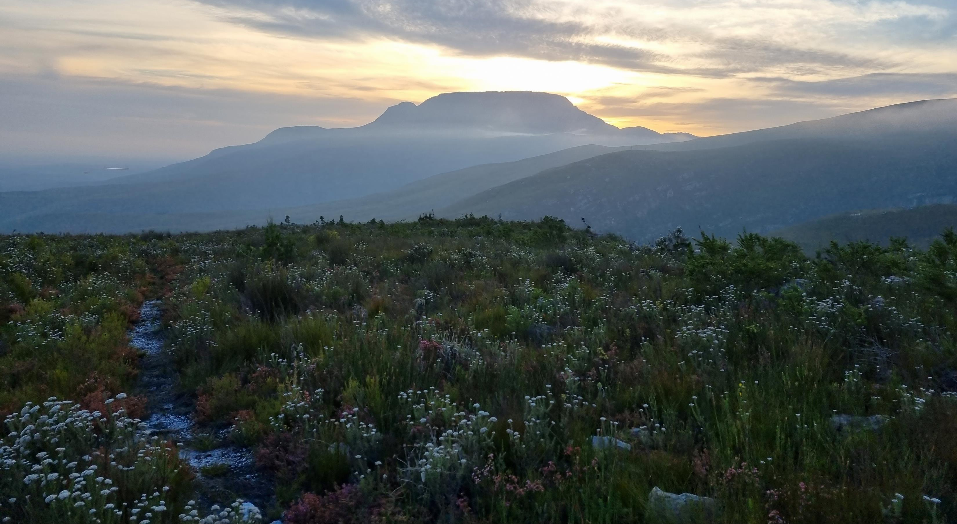
The Grootvadersbosch Conservancy covers about 30 000 ha of private land between Swellendam and Heidelberg in the Langeberg Mountain. Part of this land is high mountain catchment.
The conservancy works with private landowners to manage and protect high mountain catchment areas.

Slide 3
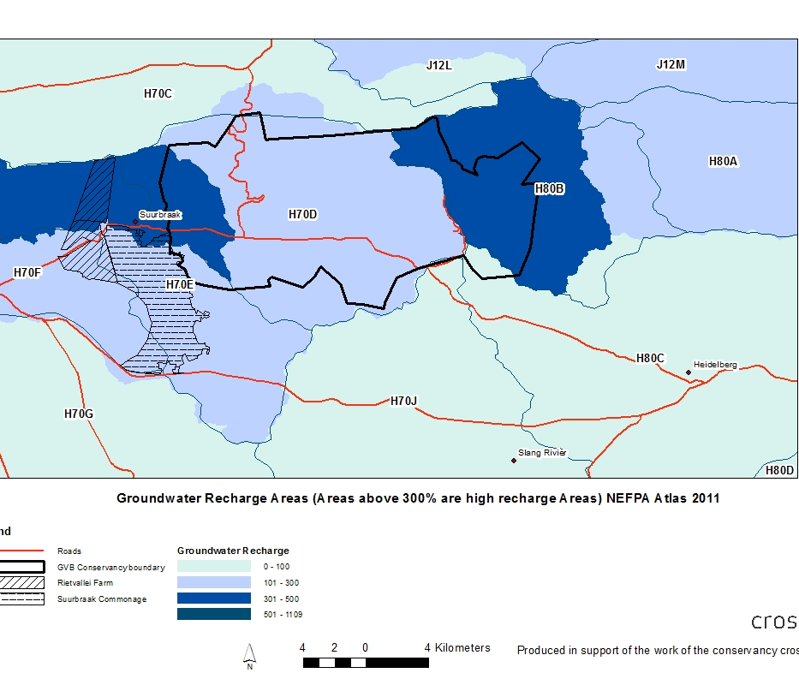
Mountain catchments have high runoff and groundwater recharge. Both are essential for sustaining river systems. Mountain catchments represent the water factories of the country.

Slide 4
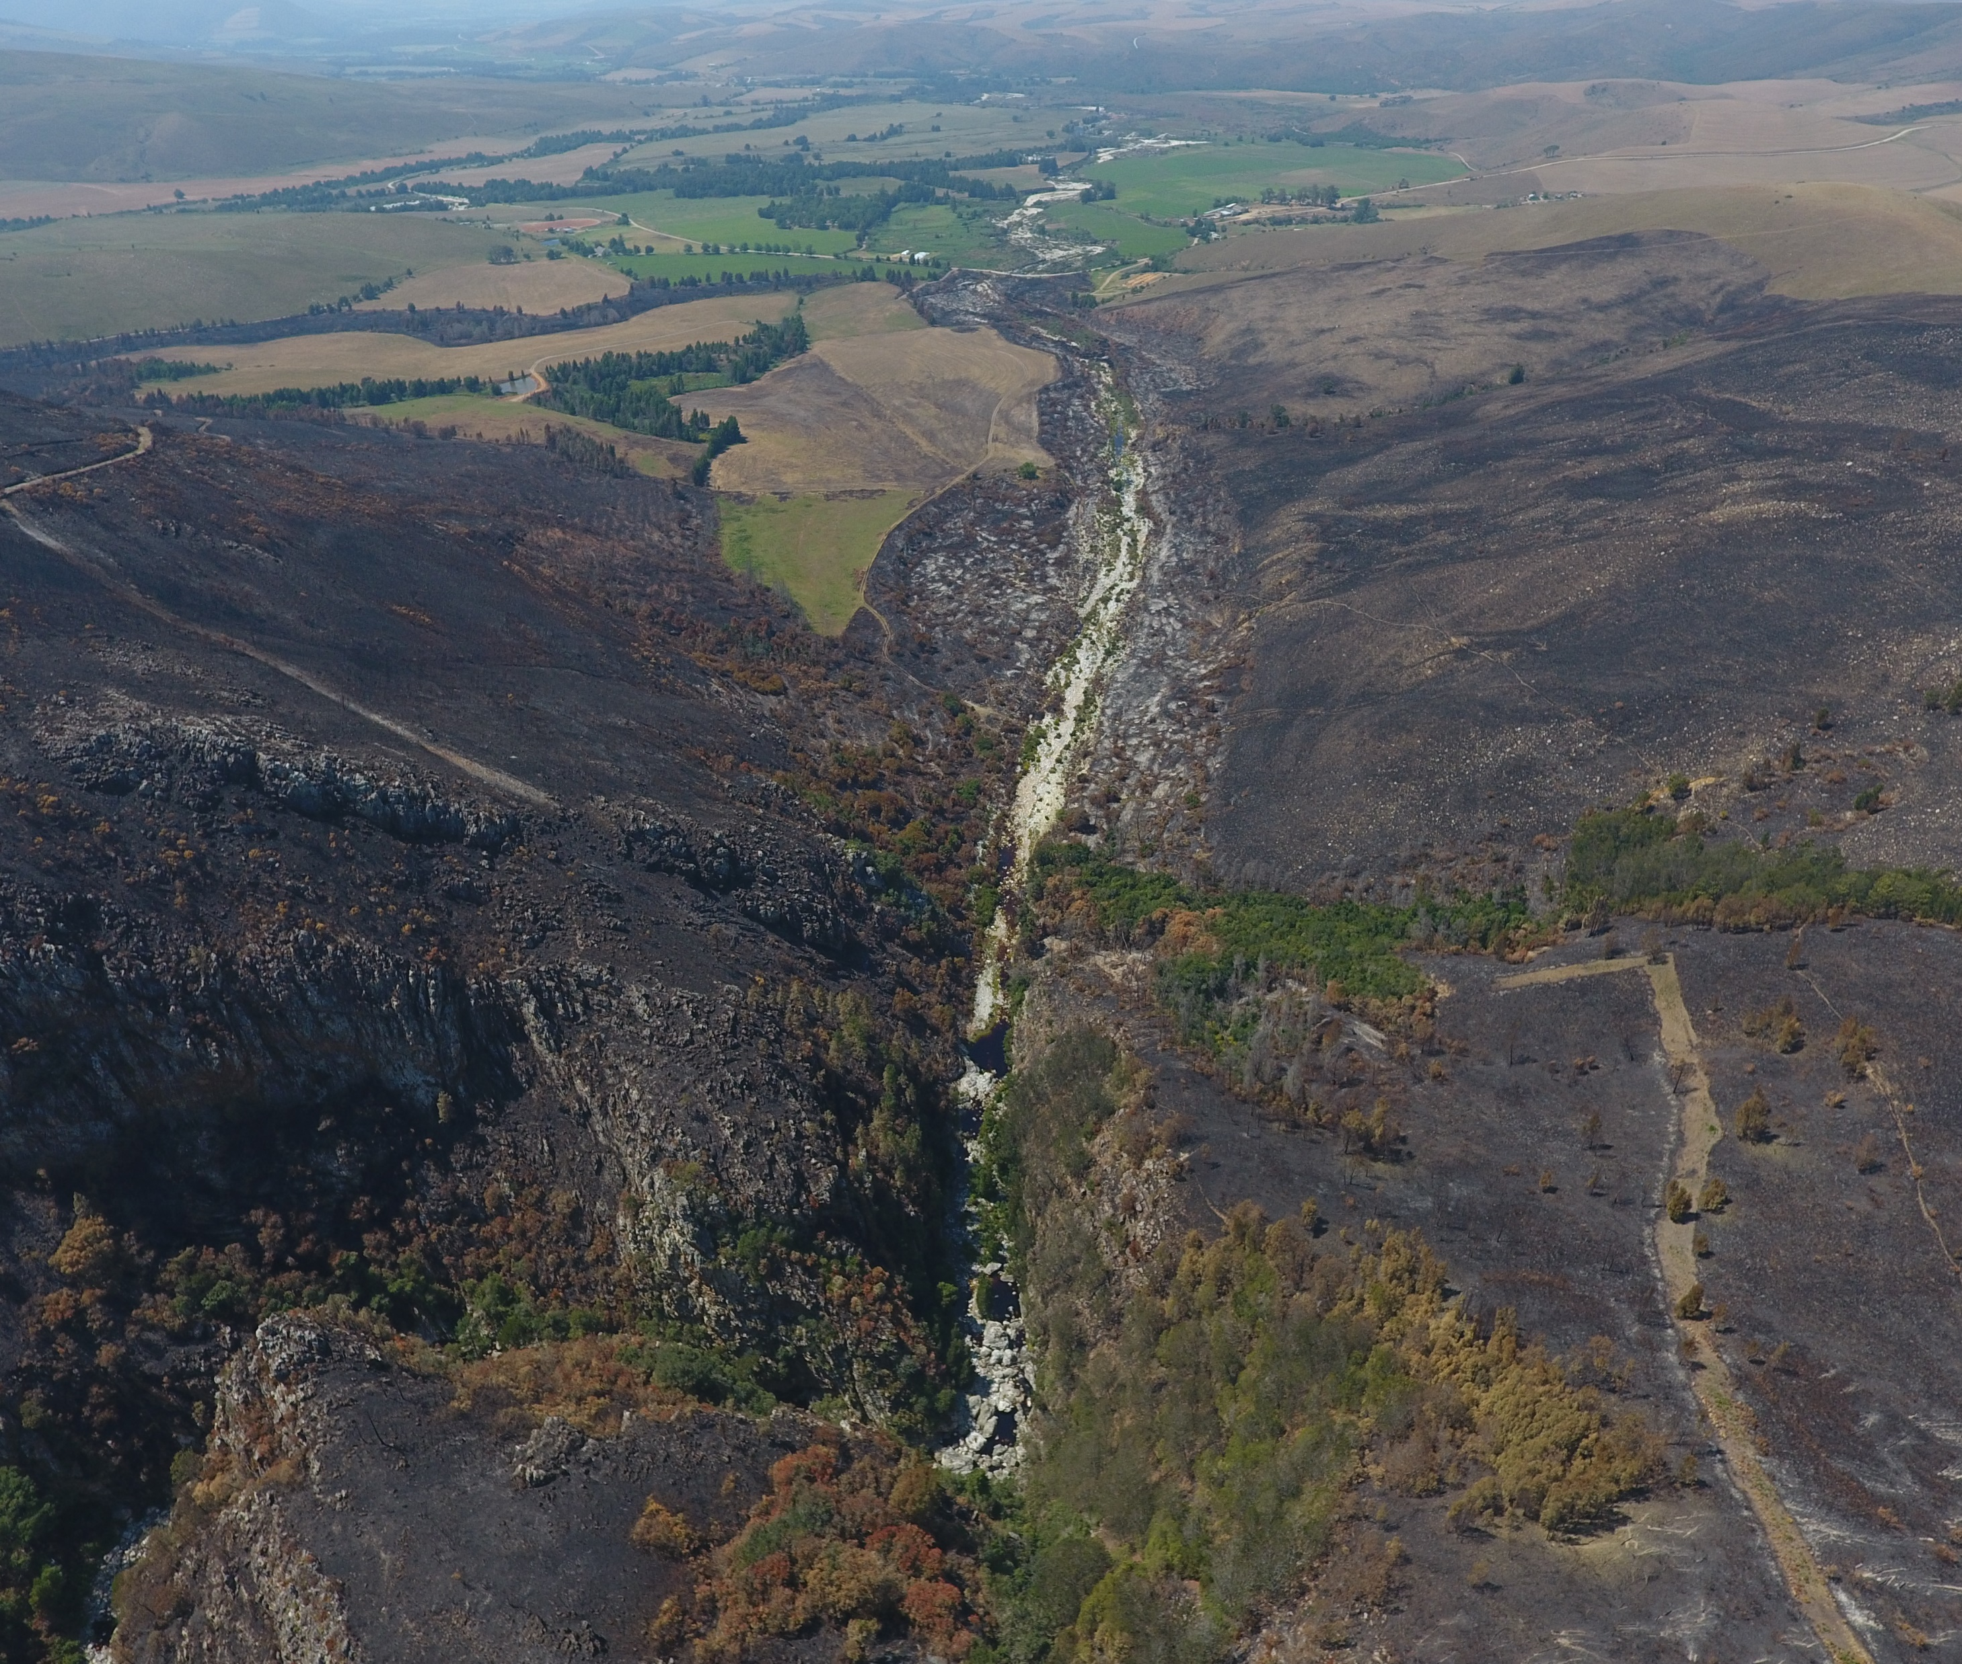
Keeping mountain catchments clear of invasive vegetation also reduces the risk of overly warm and destructive fires which pose a risk to infrastructure, agricultural activities, and biodiversity.
Mountain fynbos areas need to burn every 10-15 years, but invasive vegetation makes fires much hotter and harder to control.

Slide 5
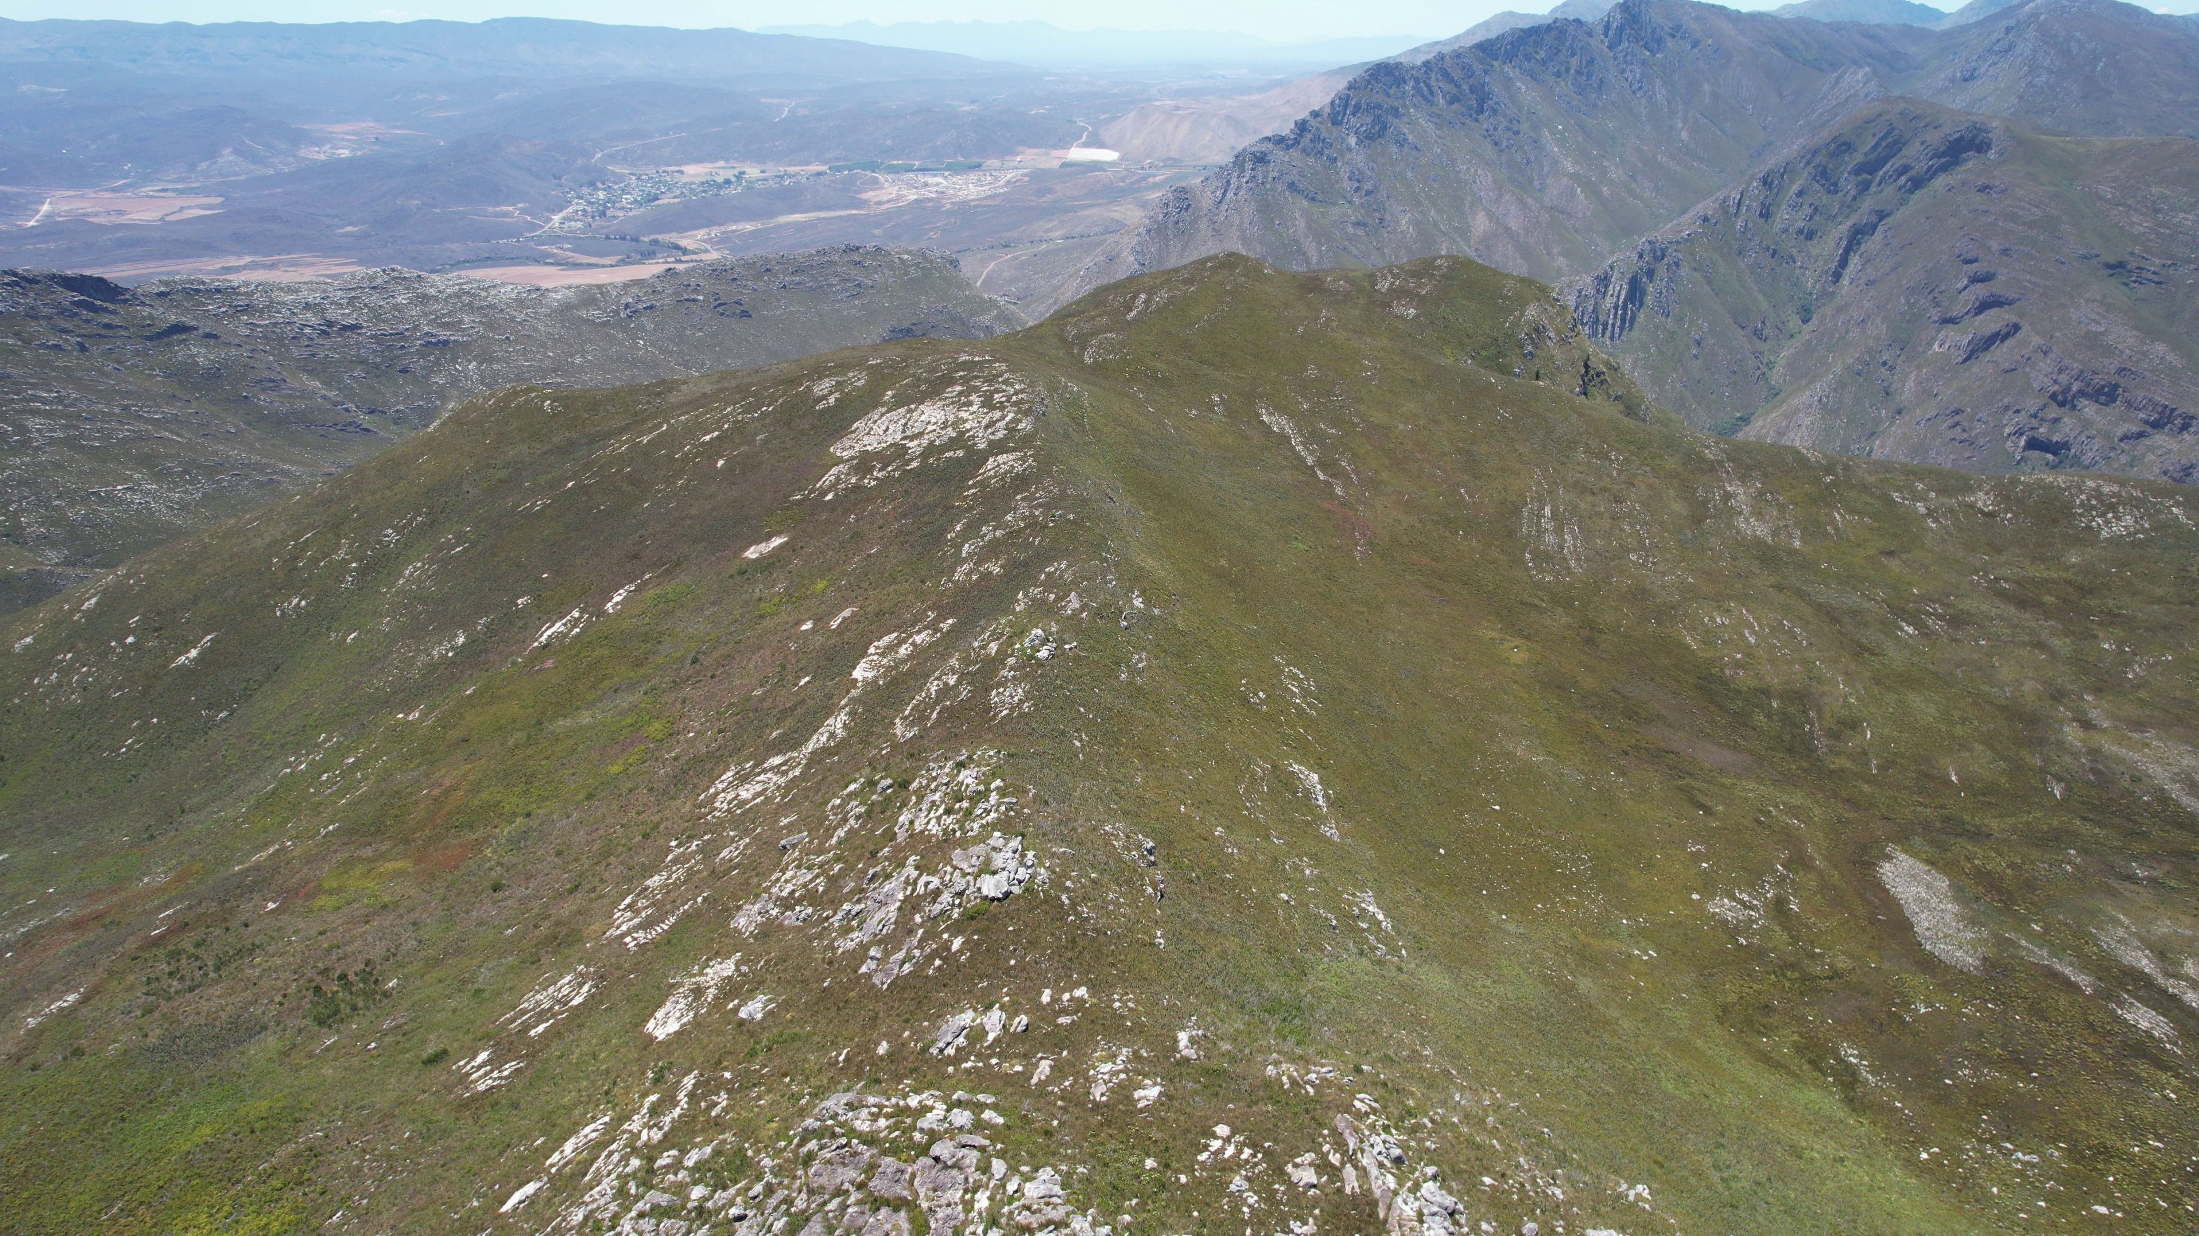
In 2020, the Grootvadersbosch Conservancy started planning an operation to clear the high mountain catchment areas of the conservancy of invasive vegetation.

Slide 6
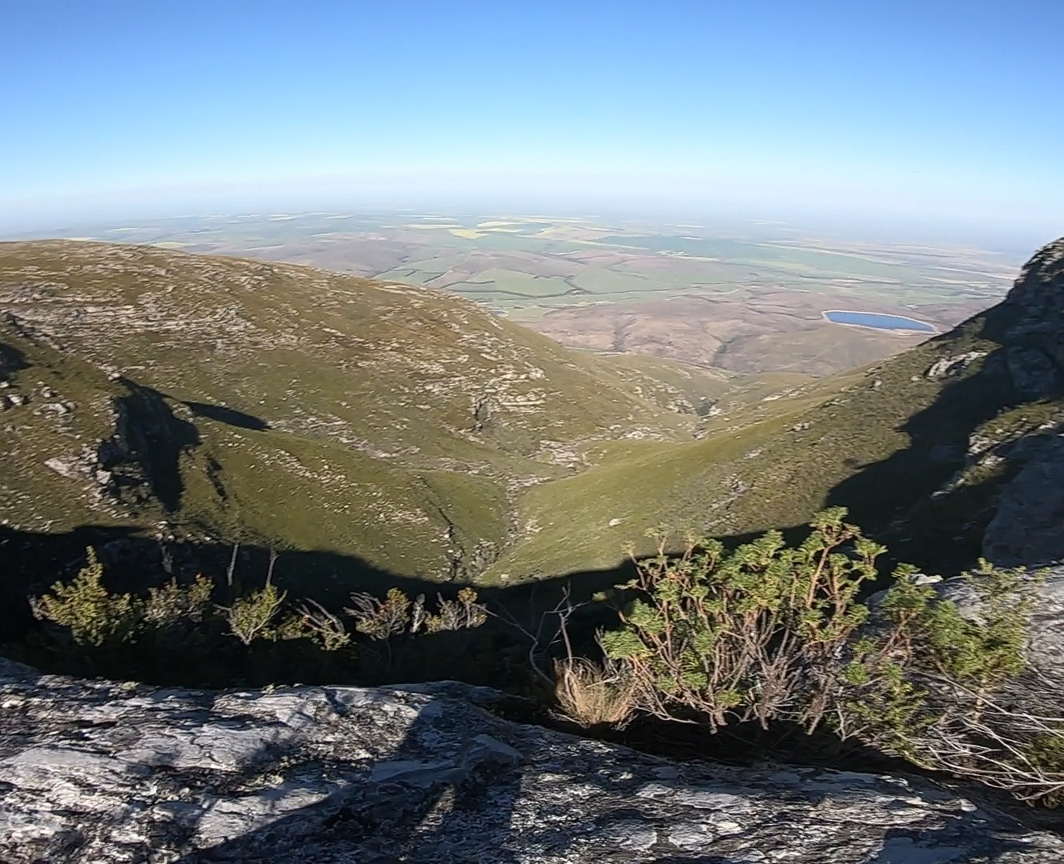
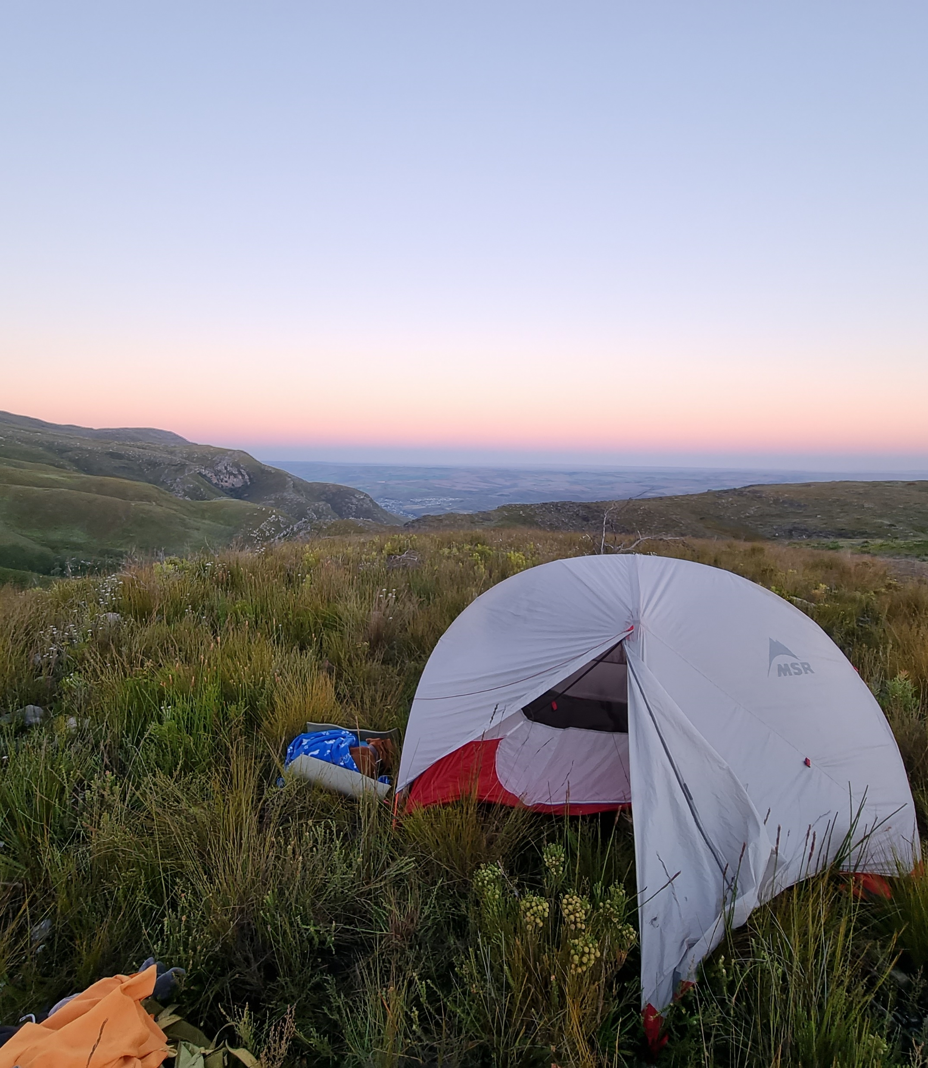
Step 1: Understanding the problem
In 2020, our General Manager spent many hours assessing the extent of the infestation and where the priorities lay.
This involved scouting high mountain areas and capturing images of the problem.
A drone was also used to scout the areas.

Slide 7
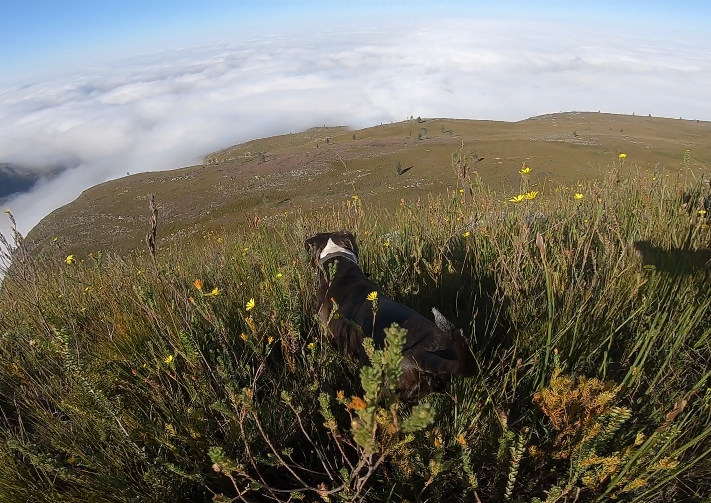
The outcome of this assessment was:
1) The infestation was scattered with two main invasives: pine and hakea.
2) The areas were accessible but only with teams camping out as most areas required a full day of hiking to reach.
3) The operation was urgent to avoid spread with costly implications as many areas did not yet require chainsaws and fire had made areas more accessible.

Slide 8
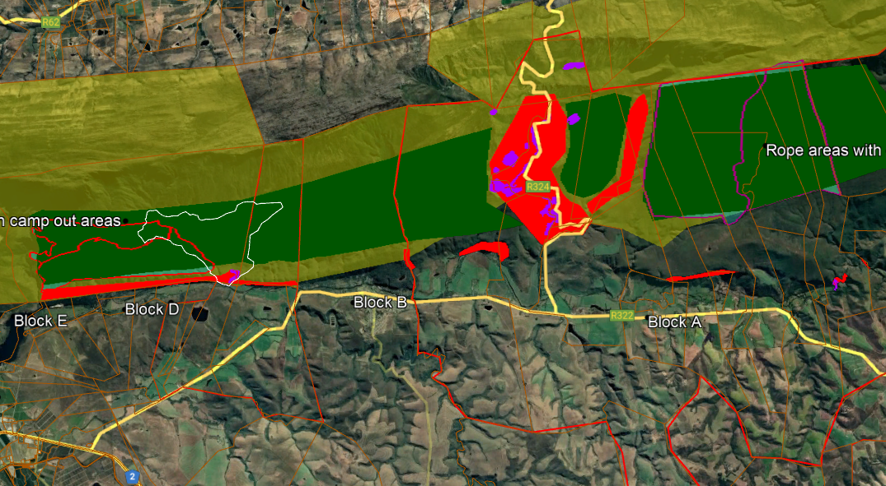
An estimated area of 6000ha was mapped into blocks with estimated days required for each operation. Recommended camp out areas were also identified near water sources.

Slide 9
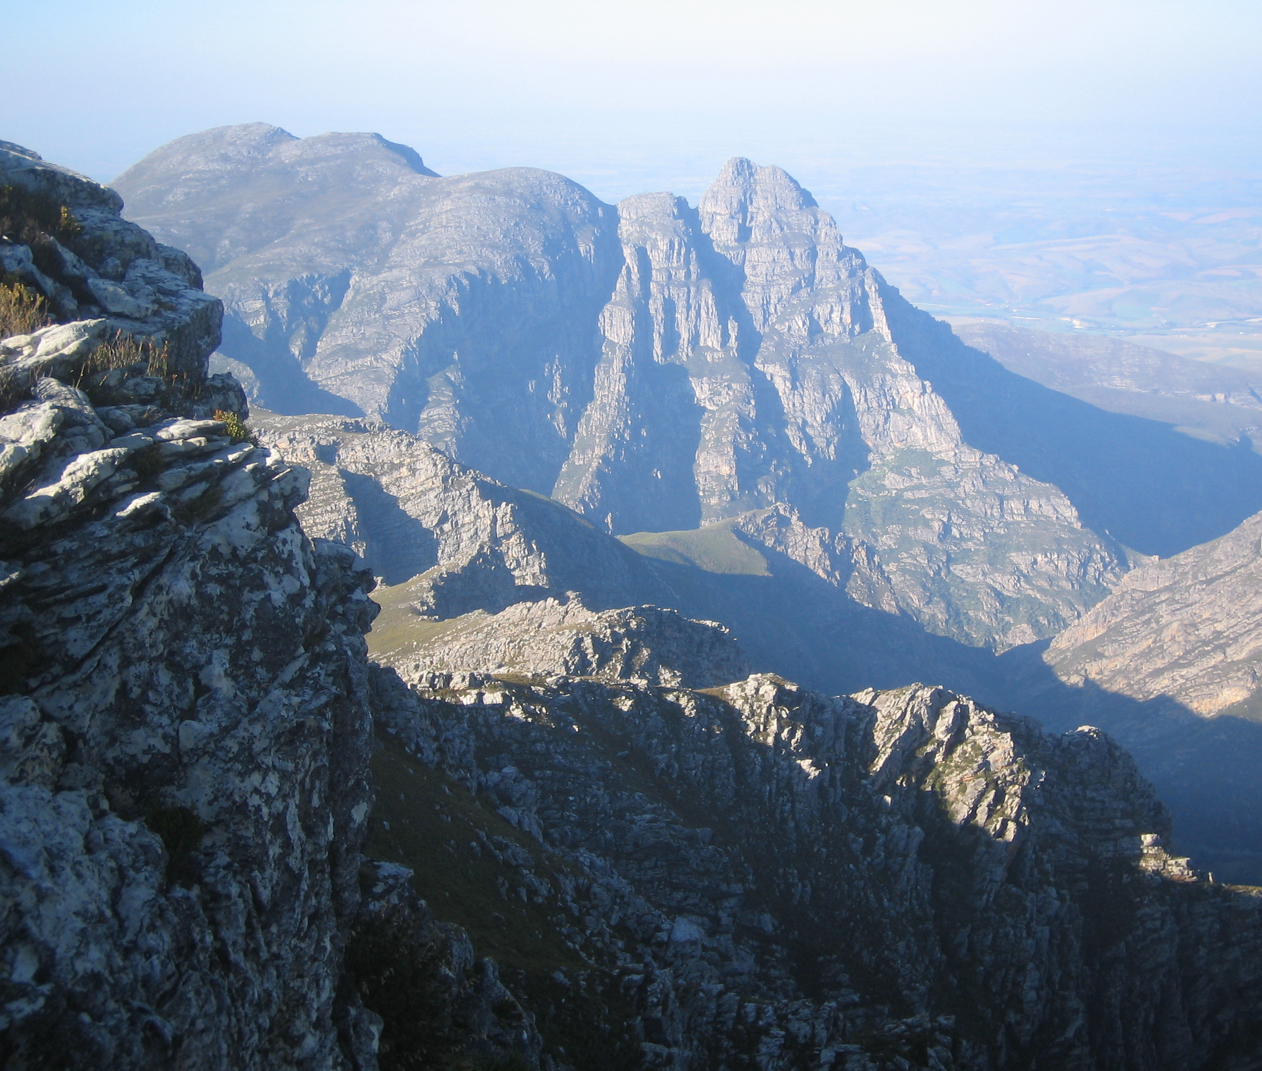
Step 2: A Partnership approach
To tackle the problem, the conservancy needed support from landowners and funders.
In 2021, funding was initially secured from landowners and the Department of Environment, Forestry and Fishers.
In 2022, Landcare and the Gouritz Biosphere Cluster Reserve also added funding to the project.

Slide 10
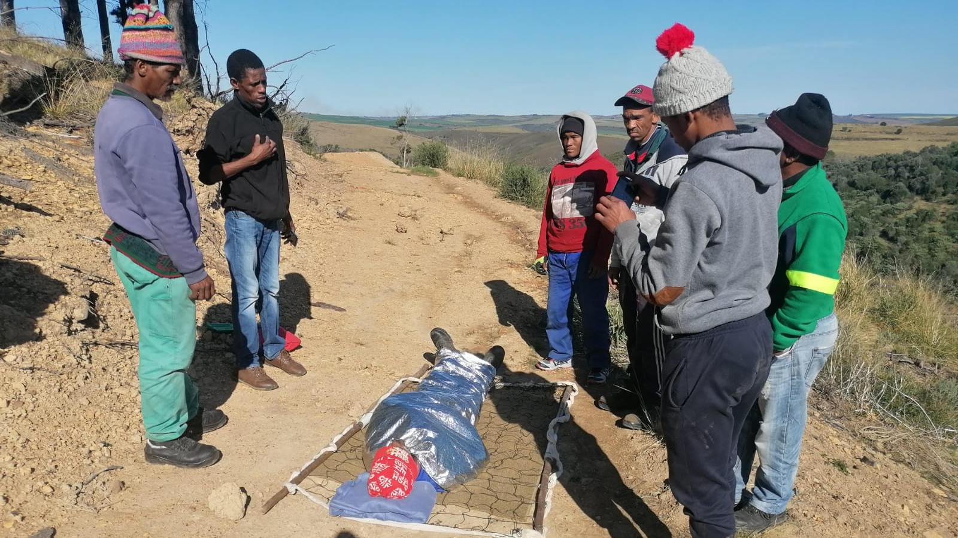
Step 3. Training
The teams received training in over night wilderness camping and first aid, which included snake awareness and response.
The training involved 45 people and was completed in September 2020 and July 2022

Slide 11
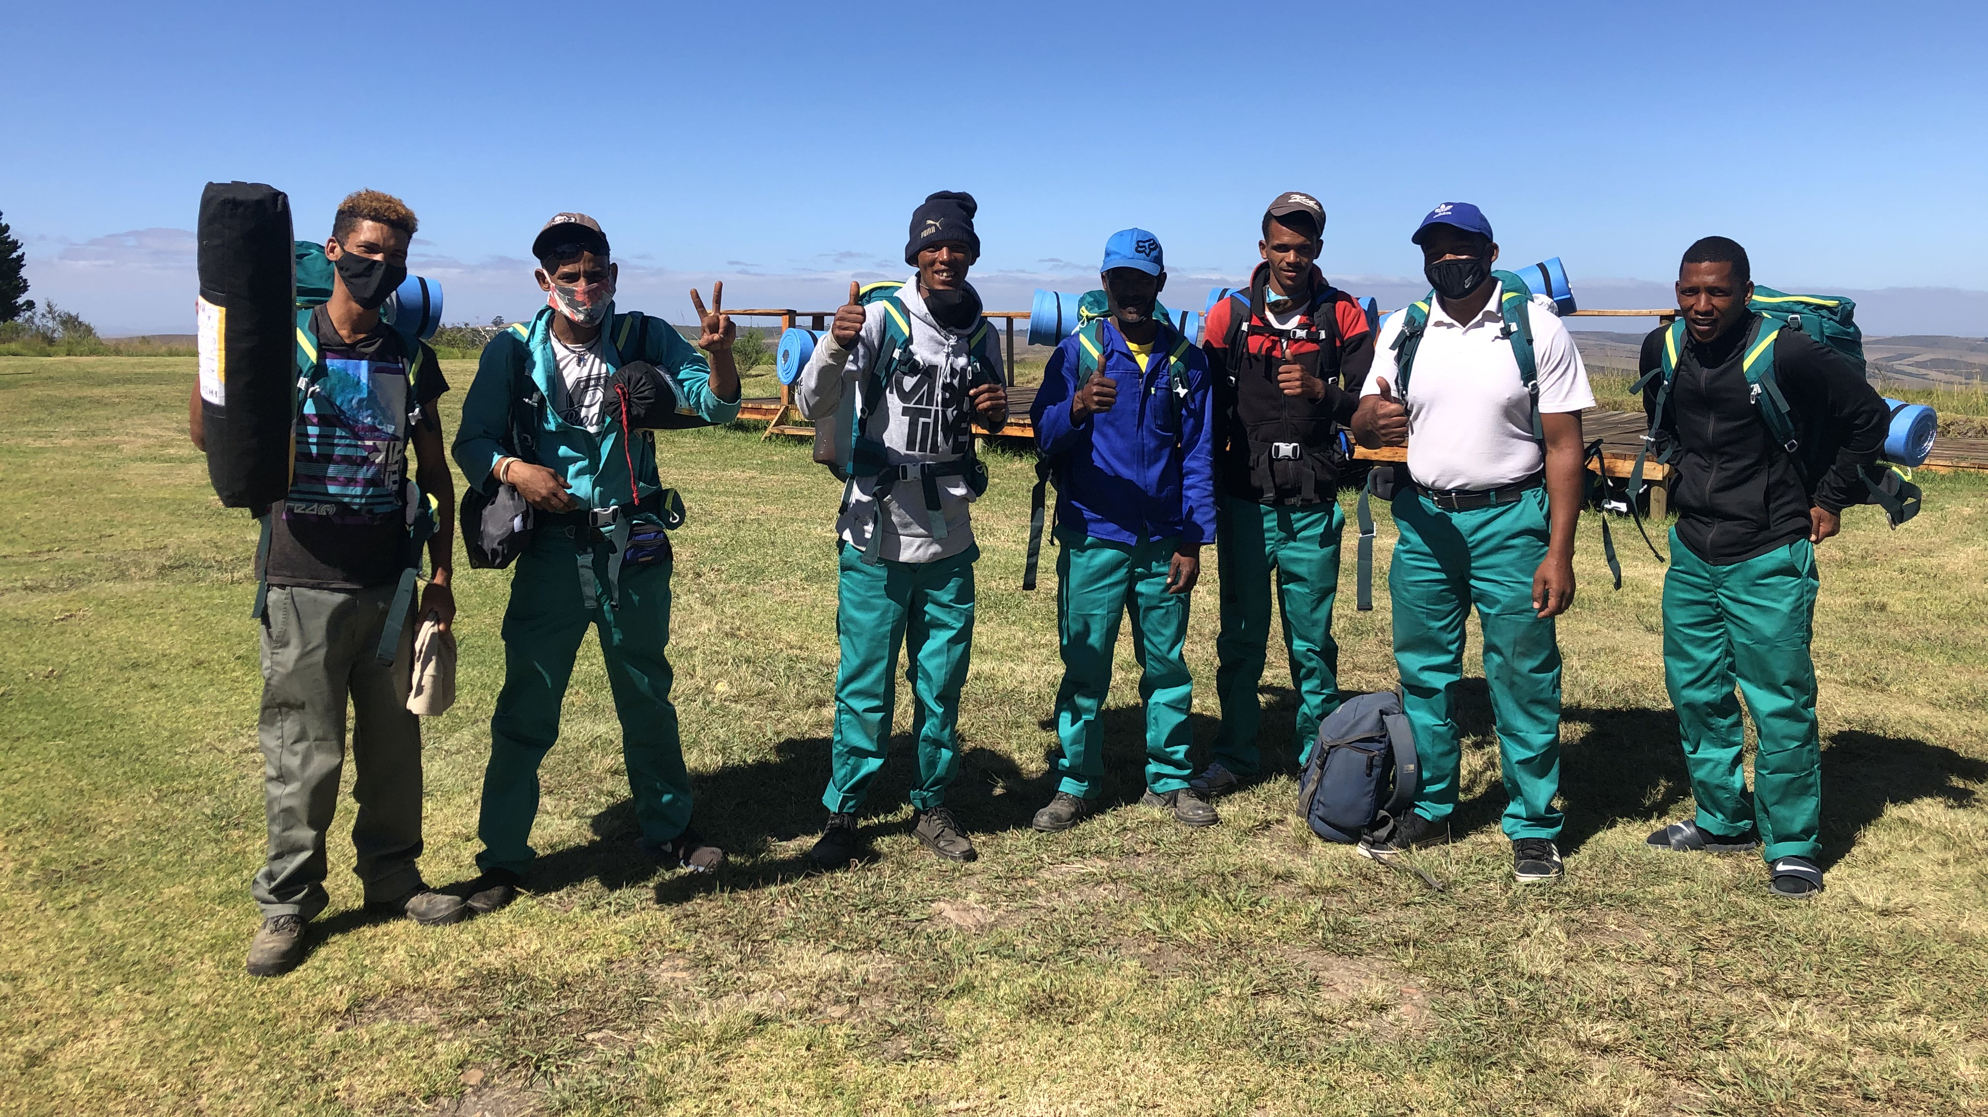
Step 4: Obtaining the right equipment
To undertake the work, the conservancy needed to obtained access to hiking equipment, which included backpacks, tents, sleeping bags, sleeping mats, flashlights and cooking stoves.
The equipment needed to be cost effective, light weight and durable.

Slide 12
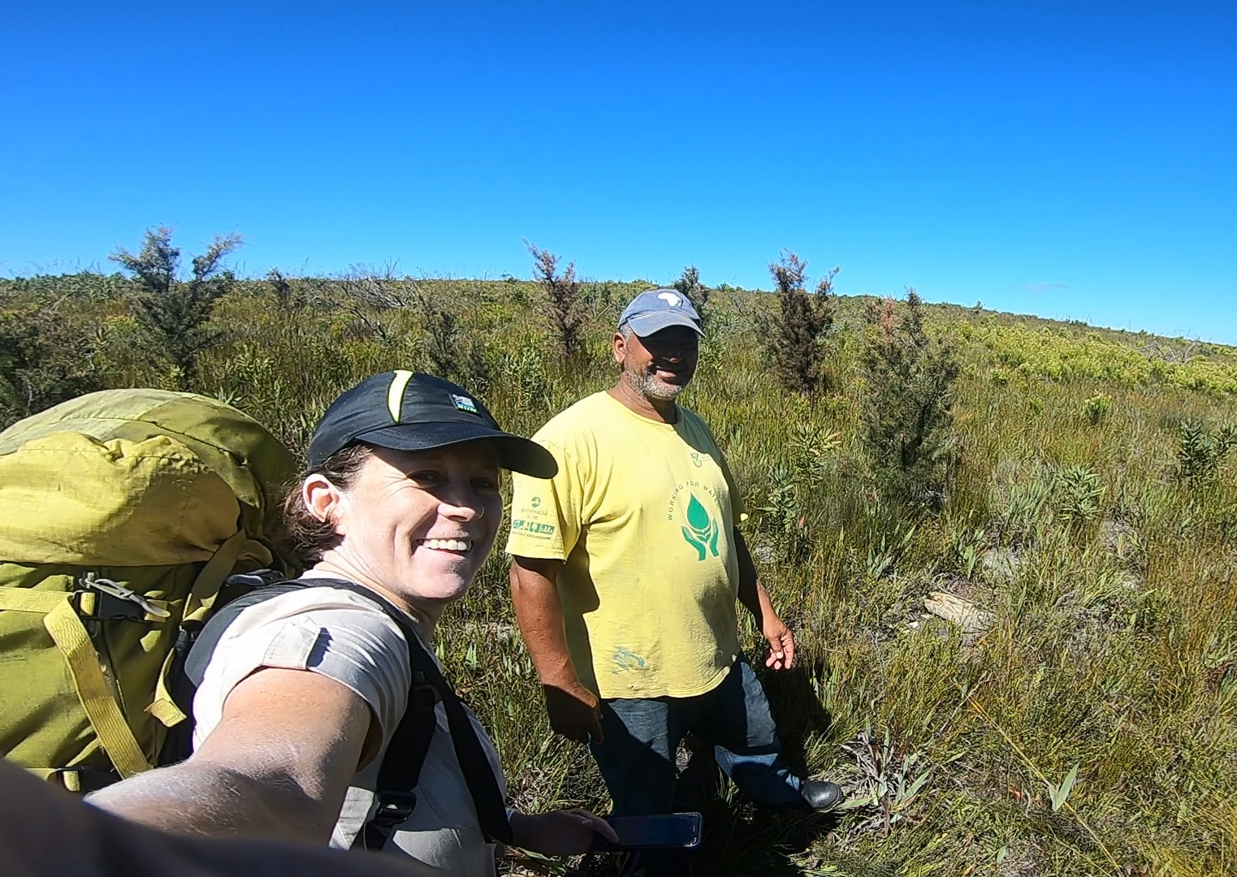
Step 5. Teams in Field
In February 2021, our first teams started operations in the mountains above Suurbraak.

Slide 13
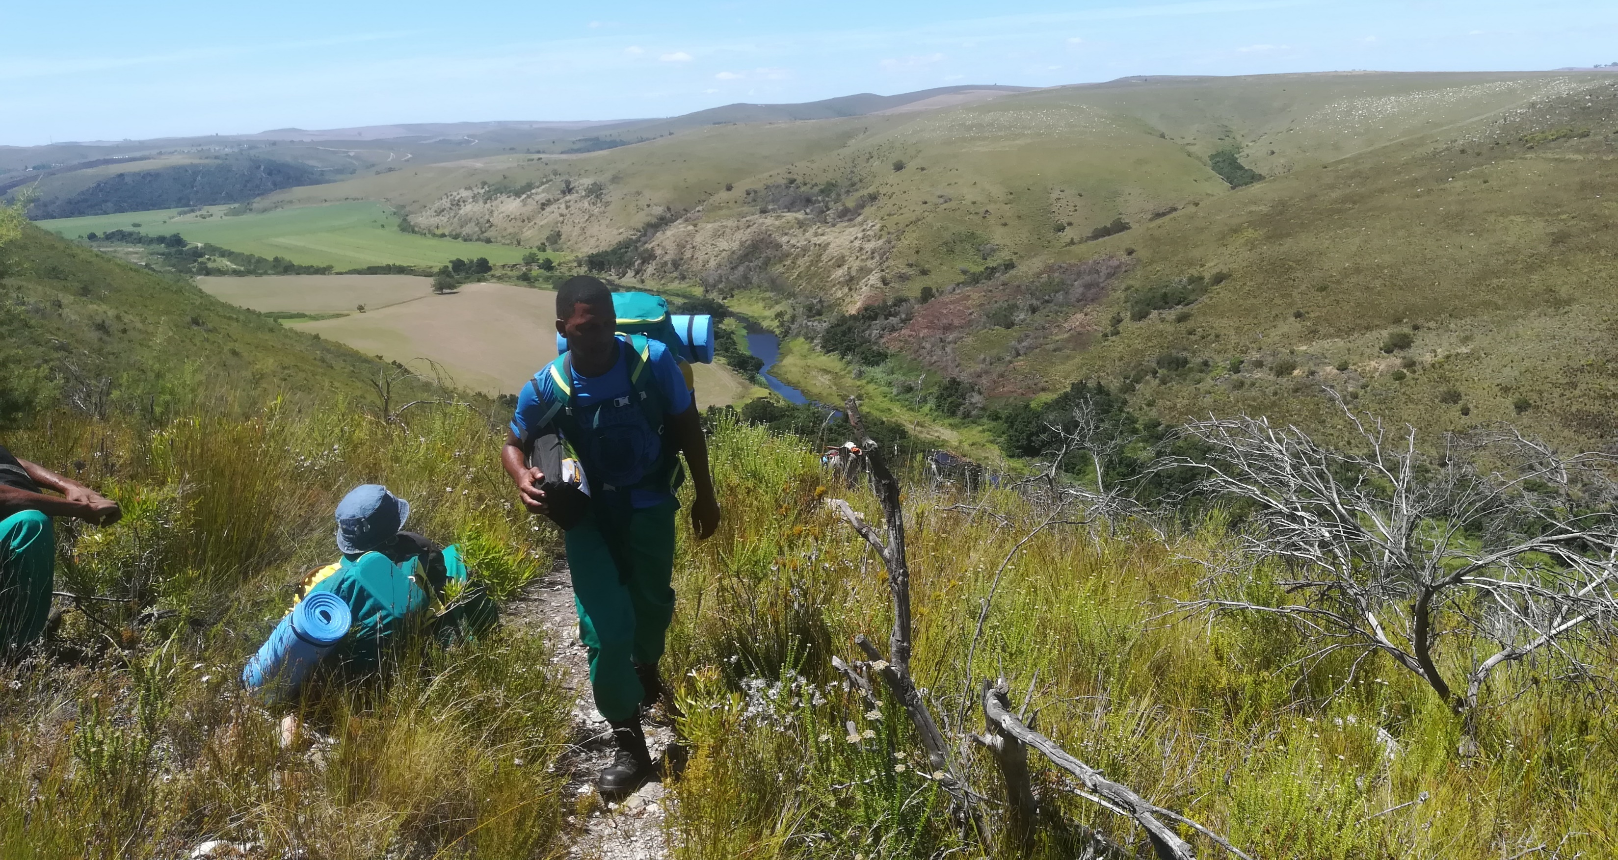
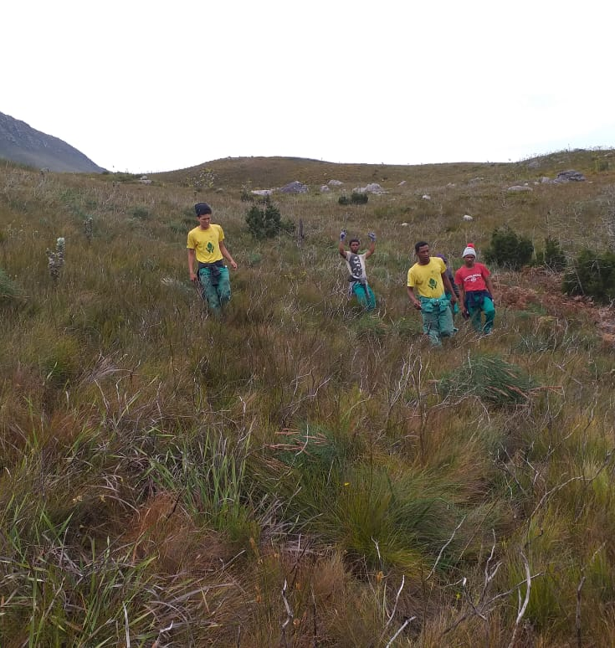
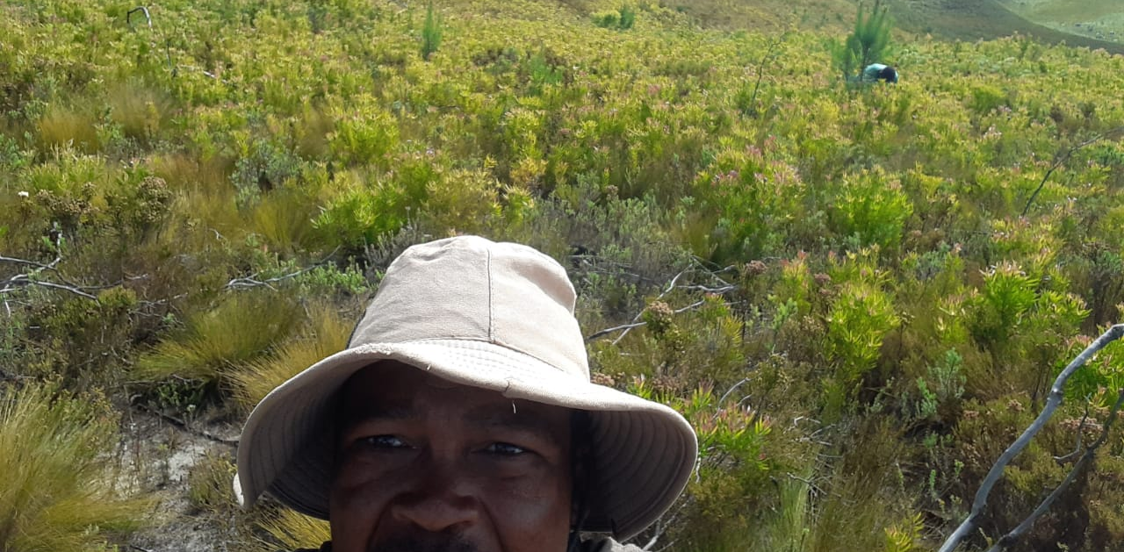

Slide 14
Here is a link to a summary of the results of our project:
https://www.youtube.com/watch?v=1LuarK5ySis&t=150s

Slide 15
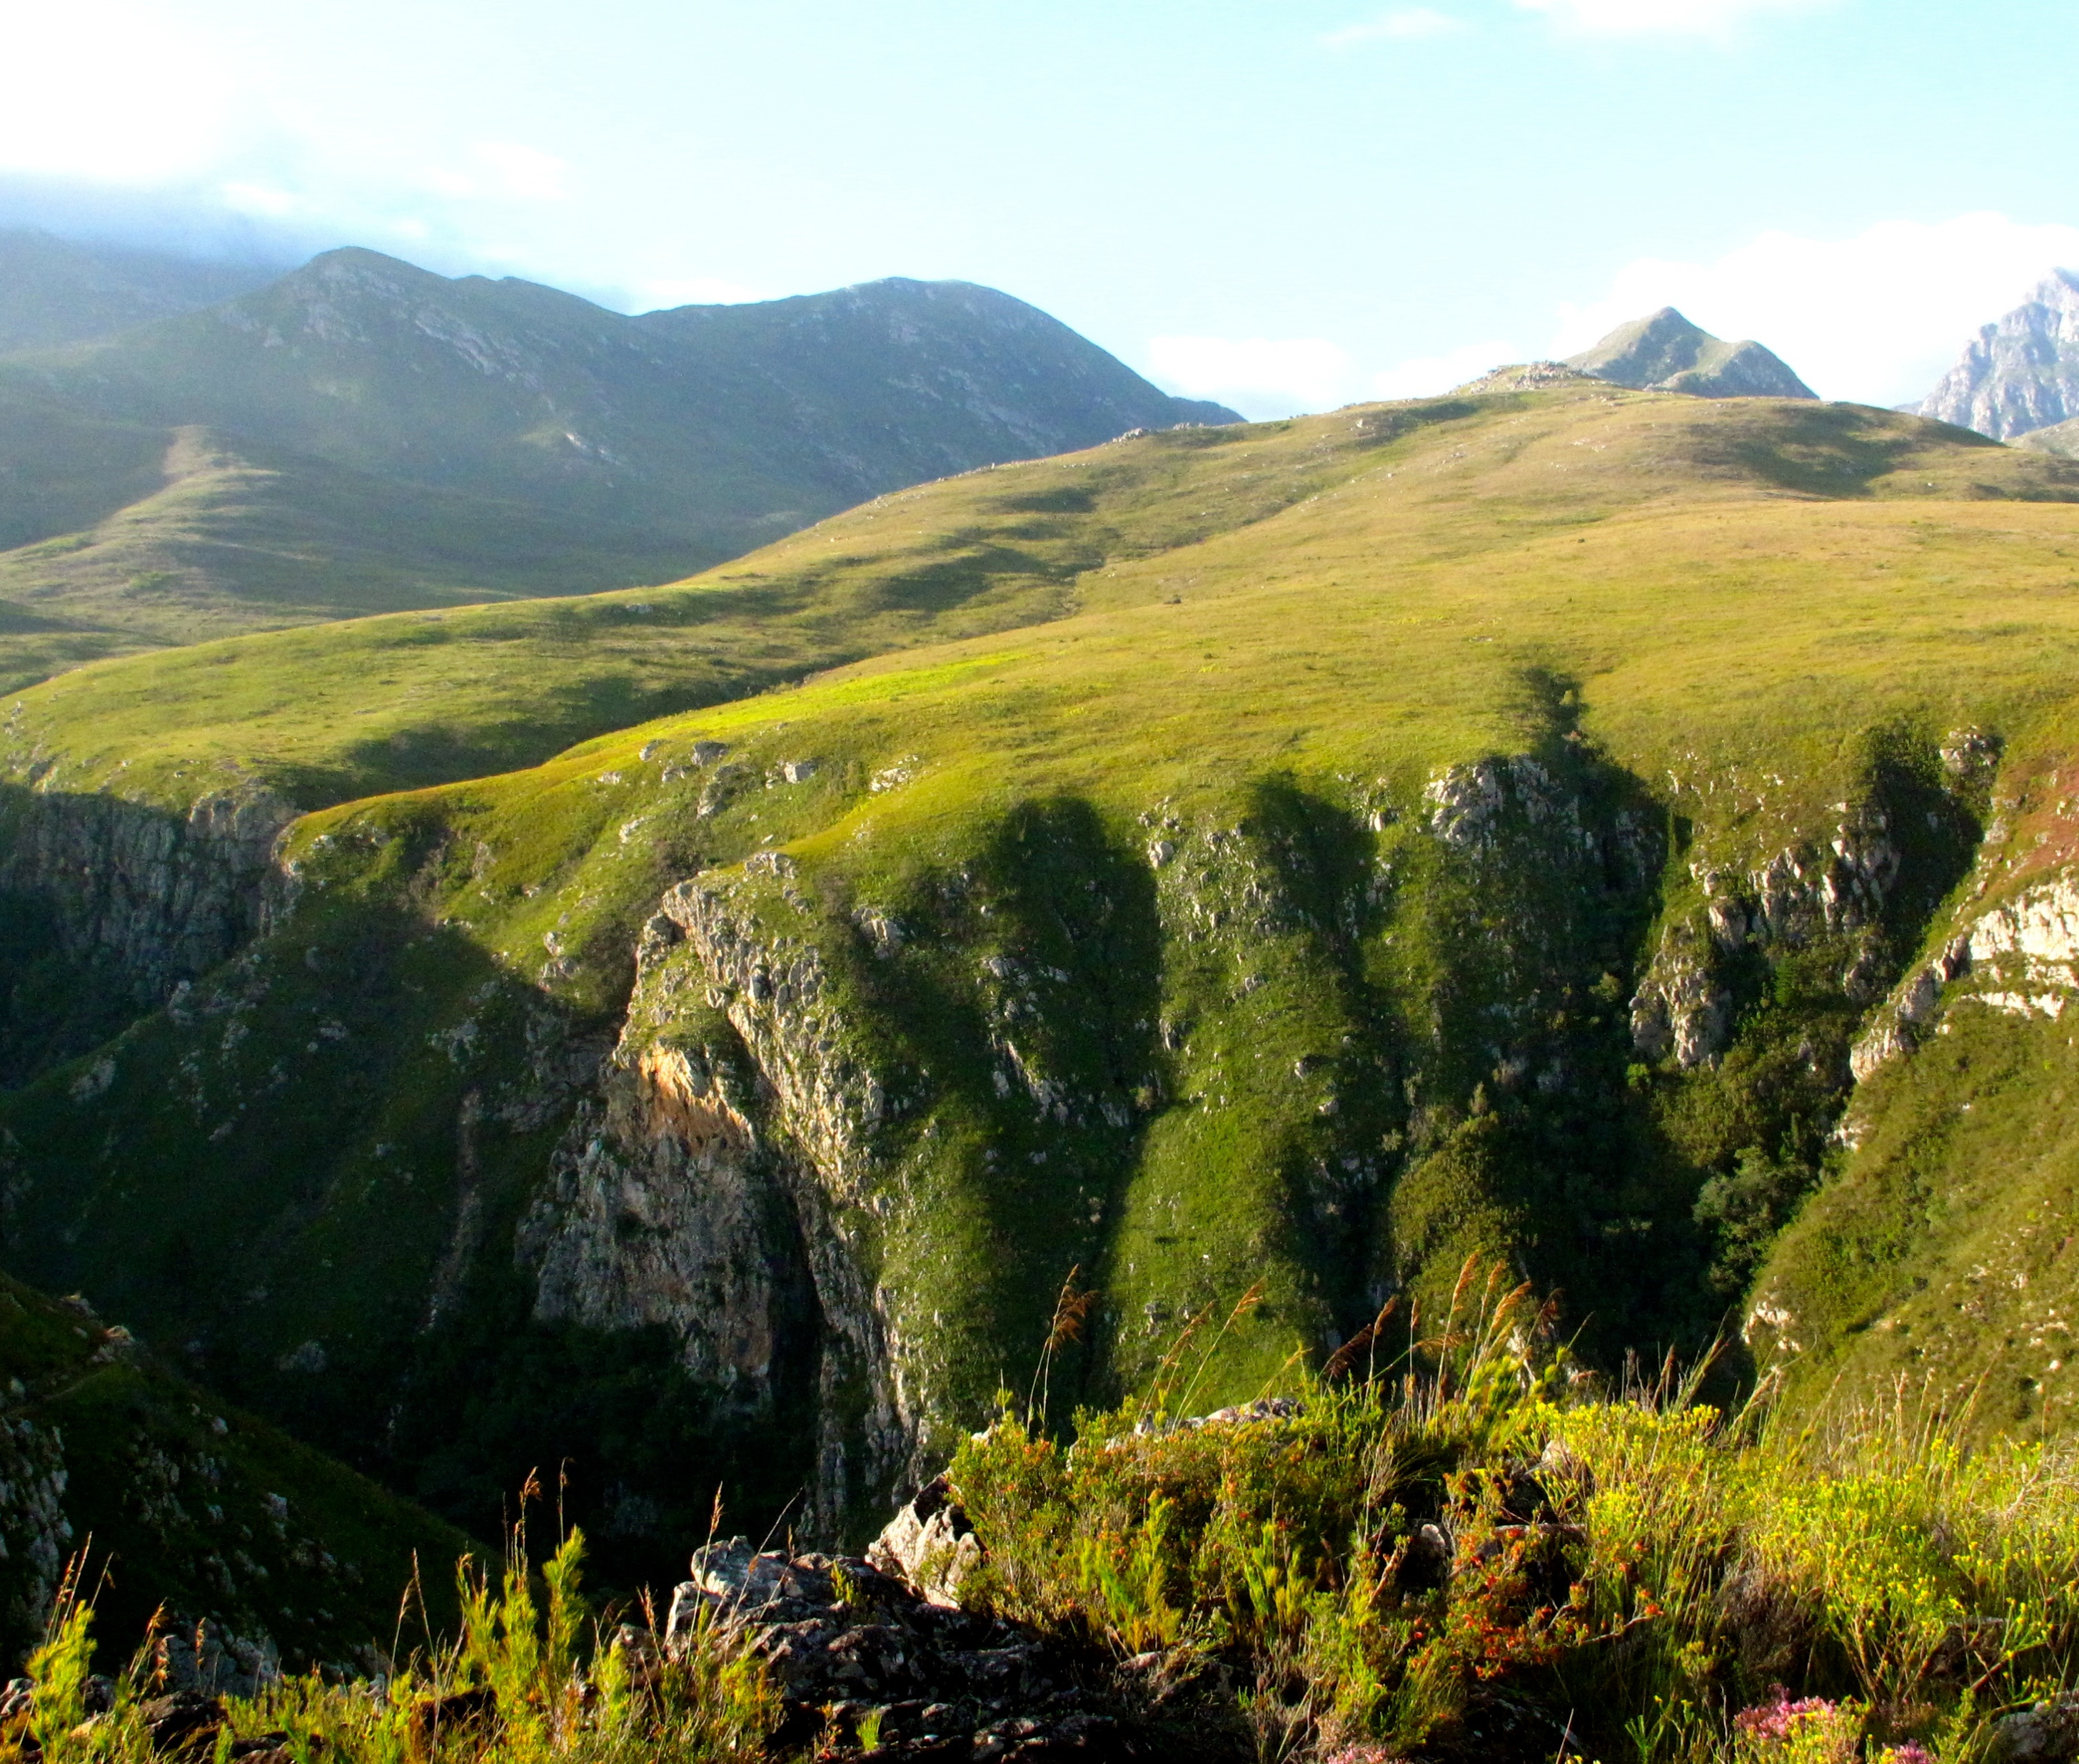
Challenges and lessons learnt
Management and inspection of the work is time consuming.
Daily radio communication and check-ins are essential for safety.
Weather is a crucial factor and teams need at least 4 days of clear weather and no rain or mist.
Drones assist in planning and inspections but cannot replace being on site.
Although most work can be done with a silky saw, a small petrol chainsaw is worth having to remove large pines that continue to seed.
The work is on going as follow up is constantly required to control small hakea and pine seedlings that can't be seen in walk throughs.

Slide 16
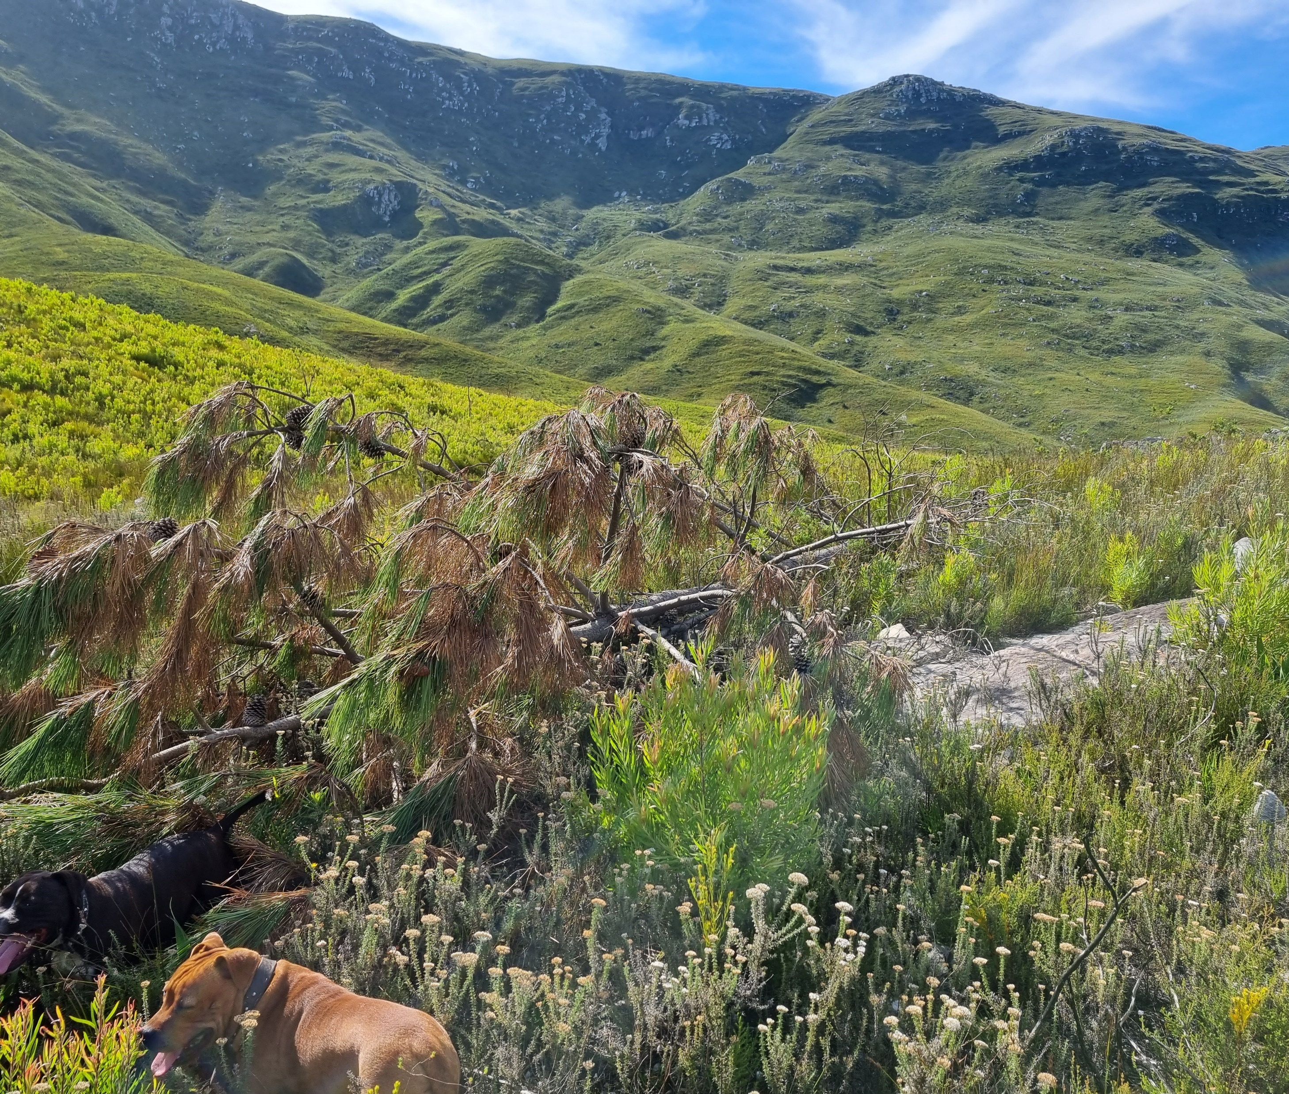
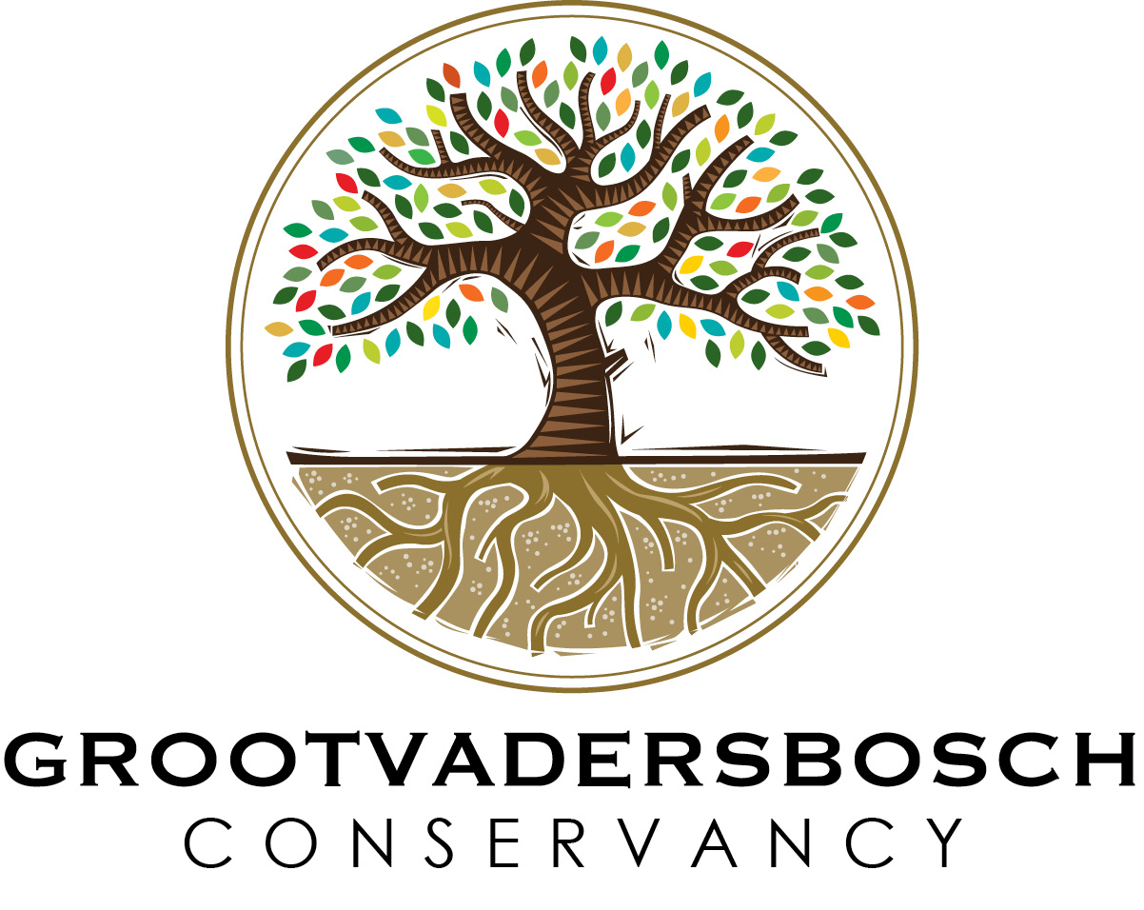
Thank you to our funders.
Well done to the teams for the successful implementation to date.
We look forward to continuing with the work which is essential for protecting our mountains and rivers.

